Slide 1

HOUSE OF QUALITY
EIN6510 - Principles of Manufacturing Systems Engineering
Team 2 - G²
Chenchu Sakthi Charan Kondugari, Sameer Pawar, Chad Tucker, Samrudh U P, Chenyu Yang
Feb 15th

Slide 2

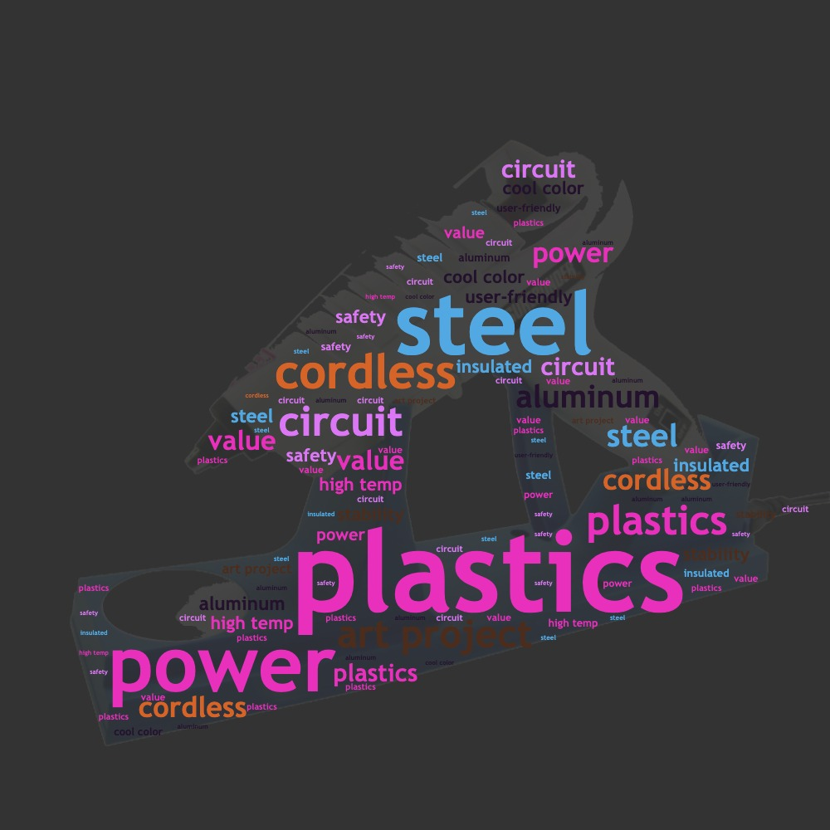
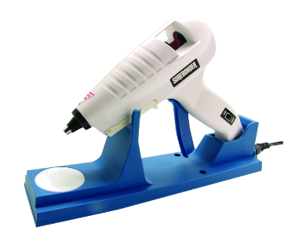
Team 2 Product
Cordless Glue Gun

Slide 3
Customer Survey
Personal Information. - Age. - Income. -Spending capacity.
Customer needs. - Do they really need it? - Personal preferences.
Questionnaire. - Does size matter? - Does shape matter? - Does weight matter? - How important is it for it to be easy to use?
- Does it have to have a good battery life? - How important is it be child safe? - Does it have to be aesthetically good?
- What should be the specifications on the refill?

Slide 4
Customer Survey
How often do you routinely make crafts as a hobby or for fun? | How important is it if the product minimizes risk of burns?
How often do you find yourself needing to repair or fix broken items made of wood, glass, plastic, or metal? | How important is it if the product can withstand high temperatures?
How important is it if the product is easy to use? | How important is it if the product has a child protective lock?
How important is it if the product is easy to control? | How important is it if the after-sales service is quick-responded?
How important is it if the product has a long battery life? | How important is it if this product uses industry standard glue sticks rather than its own brand?
How important is it if the product has an attractive and appealing appearance? | How often do you find yourself having to glue something in a week?
How important is it if the product is lightweight? | How important is it for the product to be child safe?
How important is it if the product is easy to plug in and charge? | How important is it to be able to refile easily?
How important is it if the product is durable? | How important is it for the product to be leak proof?
How important is it if the product uses industry standard glue sticks rather than its own brand and size? | How important is the products small size for handling?
How important is it if the product is relatively quiet? | How important is it for the product to be easy to clean?

Slide 5


Slide 6
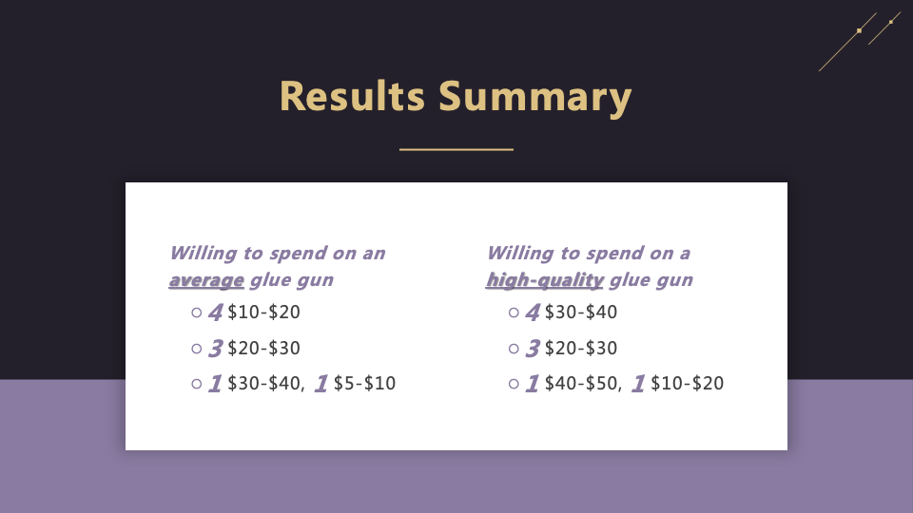

Slide 7
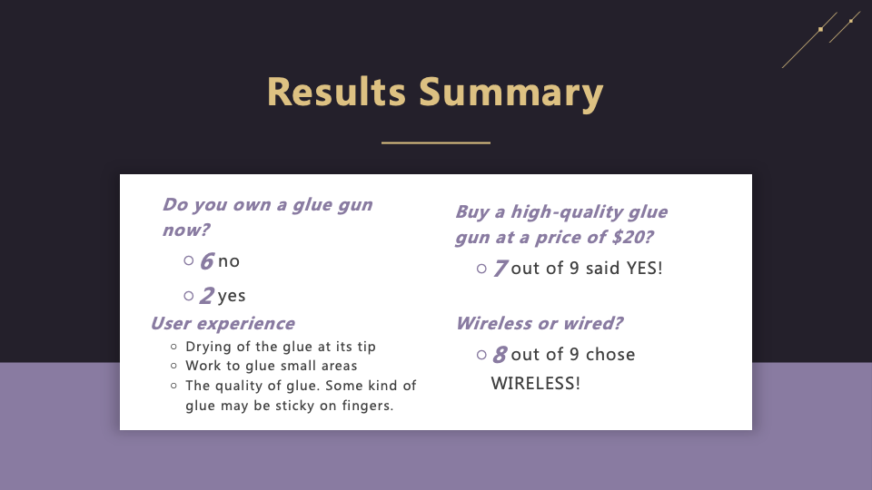

Slide 8

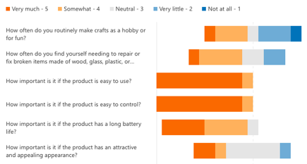
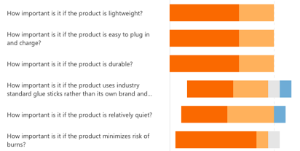
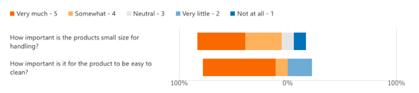

Slide 9
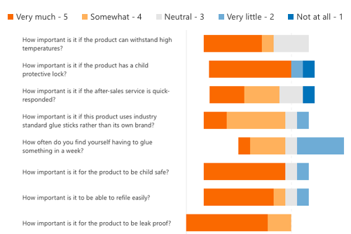
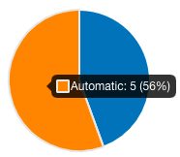

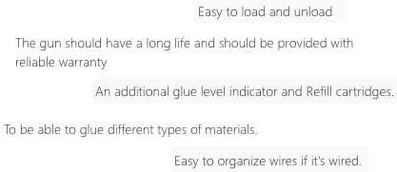

Slide 10
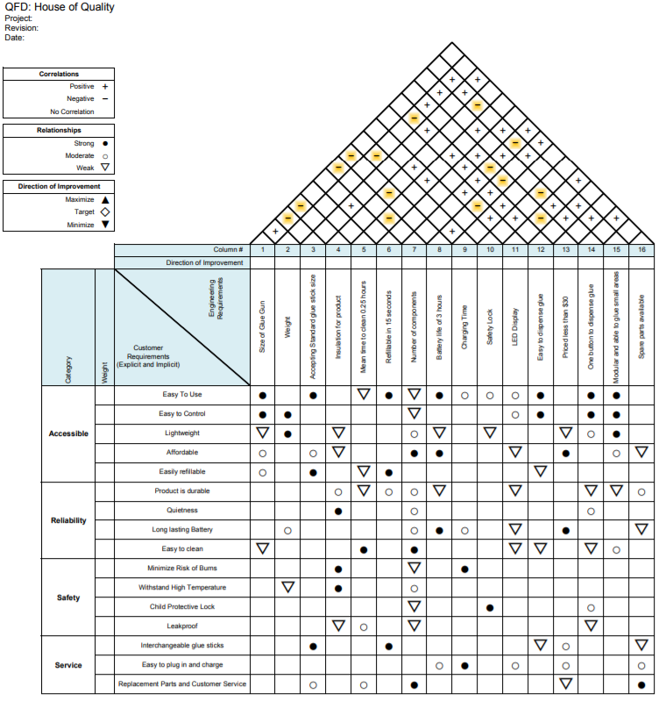
Initial House of Quality
Notes:
Here is the house of quality that we have come up with. The black solid circles show strong relationships, while the Moderate relationships are outlined by a transparent circle. The weak relationships are shown by a delta symbol. The customer requirements are taken mostly from our survey that was completed last week. Our engineering requirements were then defined by our customer requirements. The main body shows the relationship between customer needs and the product requirements. A nonlinear scale was used to weight the relationships of the House of quality.

Slide 11
Product Specifications
Compact size of glue gun.
Weight.
Battery Life of 3 hours.
Insulation for product
Plastic and metal combination for the body with a rubber grip
Modular and easy to clean.
Temperature the coil can reach to melt the glue stick.
Battery charging speed.
Size of glue sticks used should be industry standard.
Supports different sizes of nozzles for varying glue dispense.

Slide 12
Metrics & Target Values
The products Cost should be between $20-$40.
The product has to be wirelessly operated.
There is a definite need for such a product.
The product has to be easy to use.(the product should weigh less that 2kgs in total)
The product has to be easy to control. (should have a handle and liftable with one hand)
The product should have a good battery life.(a battery life of at least 2 hours per charge)
The product should be fairly decent aesthetics.
The product has to be lightweight.(weight<2kg)
The product should have high temperature tolerance and durability.(The materials used should have a temp tolerance of 100+_20*c)
It is very important for it to be child safe.(Child lock)

